Slide 1

Data Refresh Process

Slide 2

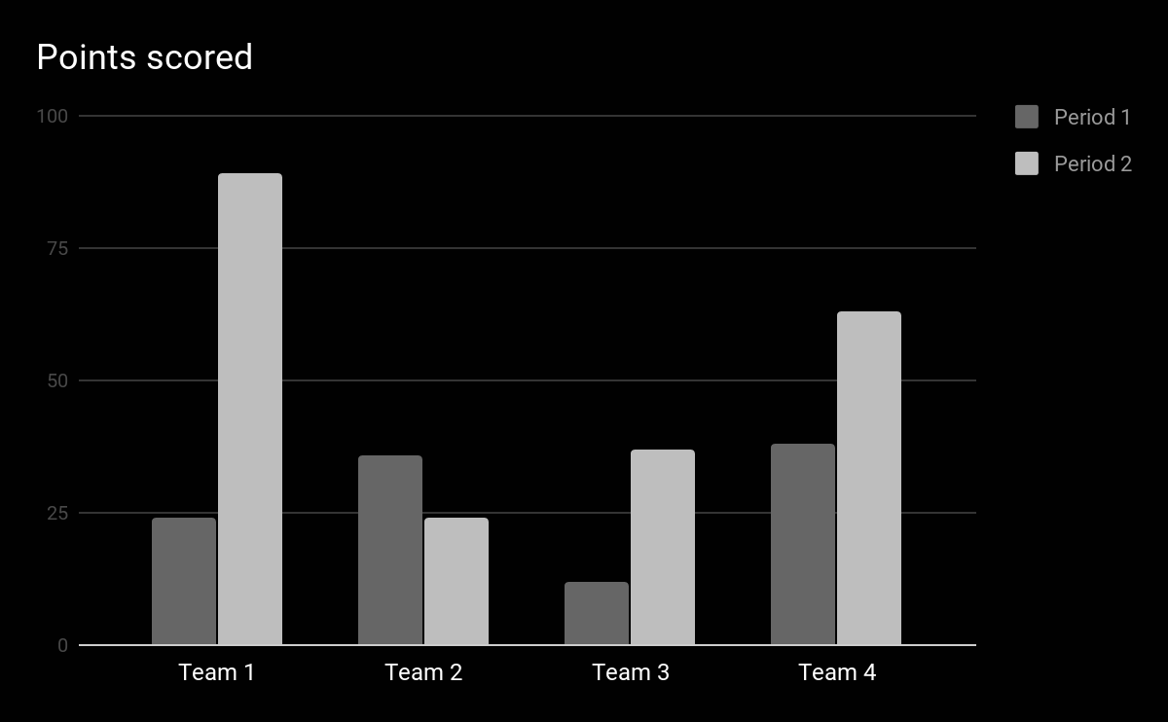

Data Refresh process(Before)
Manual Process
Raw Data
Formulas & Analysis
Power BI Dashboards
Fetch Raw data from different sources.
Use Formulas to clean and manipulate data. Establish connections between tables.
Generate dashboards using the processed data.

Slide 3

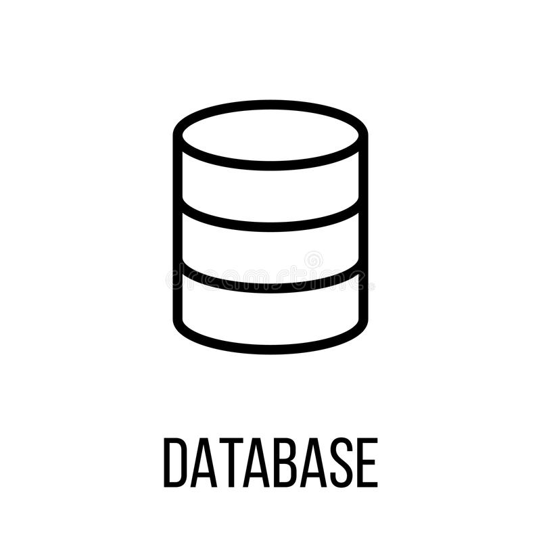

New Data Refresh Process
Automated process
Raw Data
Python Dataframes
MySQL Database
Batch file
Power BI Dashboards
Fetch data from different sources and store at a location.
Data is fetched through scripts and analysis is performed.
Data is loaded into a Server.
Script is stored as a batch file and performs refresh.
Generate dashboards by connecting server data.

Slide 4
Advantages of new refresh process
Reduces Human Intervention.
Reduces refresh time by 80% weekly.
Data cleaning & manipulation is faster compared to the manual process.
Centralized Data Repository.

